Slide 1


Slide 2
BEHOMEI
Our Positioning
Trade service + product integration + supply-chain coordination
BeHomei is a pet-product trading and supply-chain integration company,
serving global pet brands, importers, wholesalers and channel customers with integrated product solutions.
OUR CULTURE
01
Love Pets
Love Pets
02
Professional
Professional
03
Innovation
Innovation
04
Partnership
Long-term Partnership
BEHOMEI | LOVE PETS, BETTER HOME.
02

Slide 3
BUYER FIRST
Built Around Buyer Needs
Less process, more practical value: right products, faster launch, stable replenishment
01
02
03
04
Product Selection
Private Label
Supply Stability
Market Fit
Product Selection
Private Label
Supply Stability
Market Fit
Fast product combinations by category, price band, function and channel use.
OEM/ODM, packaging, product combinations and new-product development.
Integrated manufacturing resources with coordinated quality and delivery.
Solutions adjusted to overseas brand and channel requirements.
BEHOMEI | LOVE PETS, BETTER HOME.
03

Slide 4
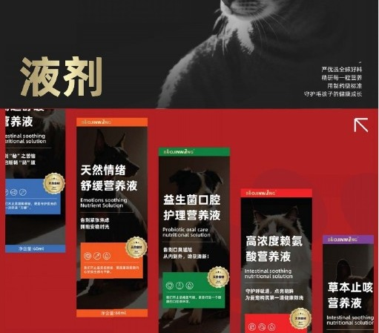
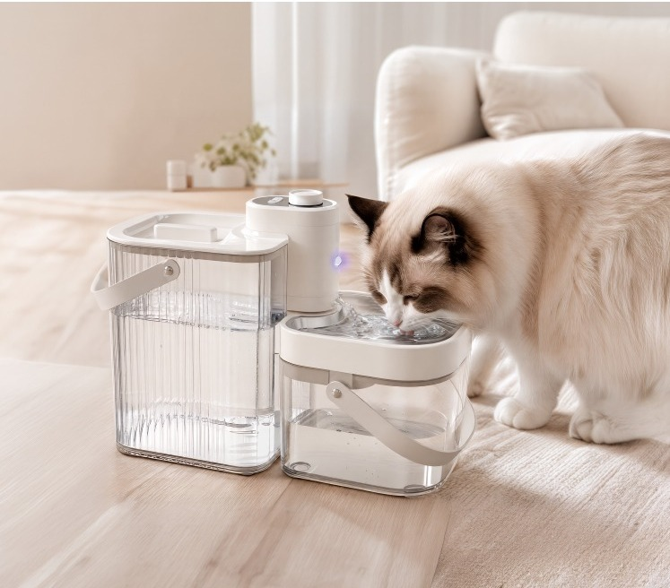
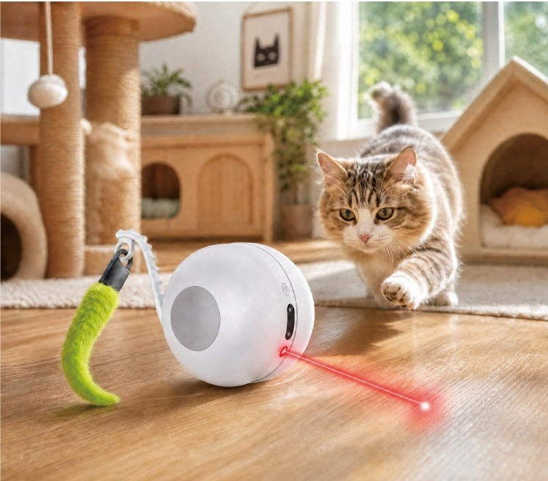
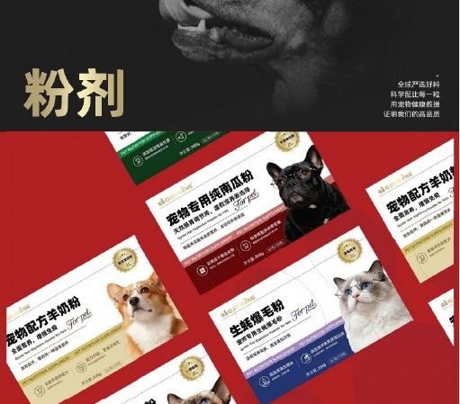
PRODUCTS
Product Portfolio
A focused multi-category portfolio for pet-product trading and channel development
01
Pet Nutrition & Functional Products
02
Smart Pet Water Fountains
Pet Nutrition & Functional Products
Smart Pet Water Fountains
Liquids, powders, pastes, tablets and soft particles
Clean/dirty separation, water/electricity separation, wireless sensing and plug-in models
03
Smart Interactive Toys
04
Private Label / OEM / ODM
Smart Interactive Toys
OEM / ODM Product Development
F1 smart interactive cat toy car
Private label, packaging, product combinations and new-product development
BEHOMEI | LOVE PETS, BETTER HOME.
04

Slide 5
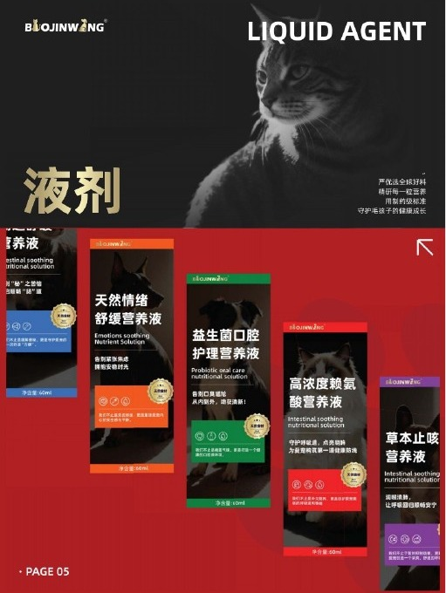
01 / PET NUTRITION
Pet Nutrition & Functional Products
Liquids, powders, pastes, tablets and soft particles designed for scalable private-label product lines.
BEHOMEI PRODUCT PORTFOLIO
BEHOMEI | LOVE PETS, BETTER HOME.
05

Slide 6
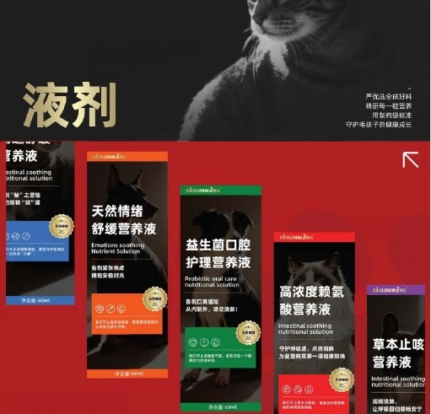
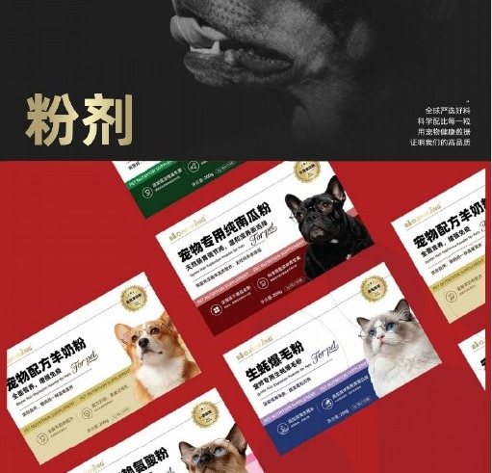
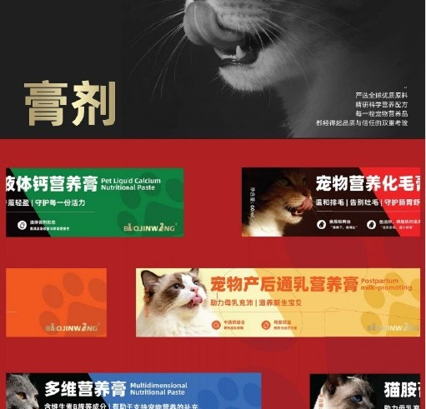
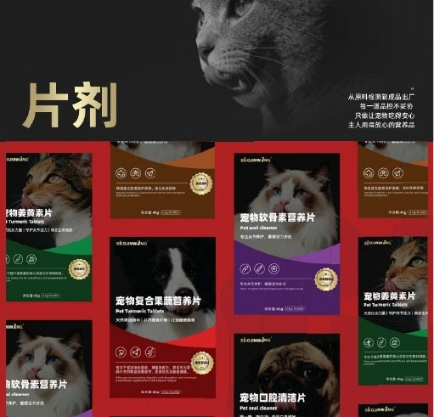
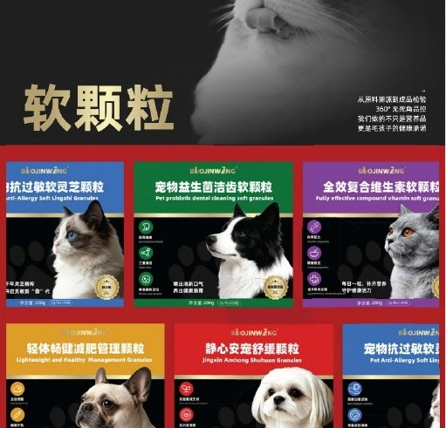
PET NUTRITION
Nutrition Product Formats
Flexible formats for different channels, price points and usage occasions
LIQUID
POWDER
PASTE
TABLET
SOFT PARTICLES
LIQUID
POWDER
PASTE
TABLET
SOFT PARTICLES
Daily / functional / scenario-based nutrition
Goat milk / probiotics / pumpkin / coat-care powders
Hairball / calcium / functional pastes
Calcium / trace minerals / multivitamins / urinary support
Lecithin / seaweed / chondroitin / multivitamins
BEHOMEI | LOVE PETS, BETTER HOME.
06

Slide 7
PET NUTRITION
Liquid Nutrition Series
Clear functional positioning for a scalable SKU family
01
Astragalus polysaccharides, vitamins, amino acids, minerals and trace elements
02
Collagen, prebiotics, fish oil, Astragalus, Codonopsis, Atractylodes and Chinese yam
Key ingredients: Astragalus polysaccharides, vitamins, amino acids, minerals and trace elements
Key ingredients: Collagen, prebiotics, fish oil, Astragalus, Codonopsis, Atractylodes and Chinese yam
Positioning: Daily nutrition and immune-system support; designed for insufficient caloric and nutritional intake
Positioning: Designed around post-operative nutrition, digestion, energy density and recovery scenarios
03
Porphyrin iron, folic acid, vitamin B12, Astragalus, Angelica and Chinese yam
04
Herbal and nutritional complex
Key ingredients: Porphyrin iron, folic acid, vitamin B12, Astragalus, Angelica and Chinese yam
Key ingredients: Herbal and nutritional complex
Positioning: Nutritional support for blood formation associated with iron, vitamin B12 or folate insufficiency
Positioning: For stress-related scenarios including food changes, transport, vaccination, climate change and fright
05
Plantain, dandelion, cranberry, Alisma and B vitamins
06
Milk calcium, milk minerals, calcium, phosphorus and vitamin D3
Key ingredients: Plantain, dandelion, cranberry, Alisma and B vitamins
Key ingredients: Milk calcium, milk minerals, calcium, phosphorus and vitamin D3
Positioning: Designed for daily urinary tract nutritional support and related scenarios
Positioning: Liquid calcium nutrition designed for convenient supplementation
BEHOMEI | LOVE PETS, BETTER HOME.
07

Slide 8
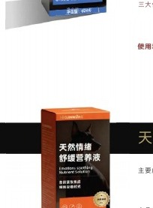
PRODUCT DETAIL
Daily Nutrition & Immune Support
Liquid Nutrition
01
KEY INGREDIENTS / FORMULATION
Astragalus polysaccharides, vitamins, amino acids, minerals and trace elements
02
PRODUCT POSITIONING
Daily nutrition and immune-system support; designed for insufficient caloric and nutritional intake
APPLICATION
DEVELOPMENT VALUE
Daily nutrition / insufficient intake
Suitable for series SKUs and private-label development
BEHOMEI | LOVE PETS, BETTER HOME.
08

Slide 9
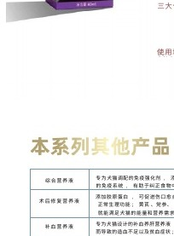
PRODUCT DETAIL
Post-operative Nutrition & Recovery
Liquid Nutrition
01
KEY INGREDIENTS / FORMULATION
Collagen, prebiotics, fish oil, Astragalus, Codonopsis, Atractylodes and Chinese yam
02
PRODUCT POSITIONING
Designed around post-operative nutrition, digestion, energy density and recovery scenarios
APPLICATION
DEVELOPMENT VALUE
Post-operative recovery / energy support
Suitable for series SKUs and private-label development
BEHOMEI | LOVE PETS, BETTER HOME.
09

Slide 10
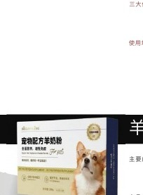
PRODUCT DETAIL
Blood Support Nutrition
Liquid Nutrition
01
KEY INGREDIENTS / FORMULATION
Porphyrin iron, folic acid, vitamin B12, Astragalus, Angelica and Chinese yam
02
PRODUCT POSITIONING
Nutritional support for blood formation associated with iron, vitamin B12 or folate insufficiency
APPLICATION
DEVELOPMENT VALUE
Nutritional blood support / young pets
Suitable for series SKUs and private-label development
BEHOMEI | LOVE PETS, BETTER HOME.
10

Slide 11
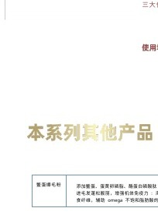
PRODUCT DETAIL
Stress Support Nutrition
Liquid Nutrition
01
KEY INGREDIENTS / FORMULATION
Herbal and nutritional complex
02
PRODUCT POSITIONING
For stress-related scenarios including food changes, transport, vaccination, climate change and fright
APPLICATION
DEVELOPMENT VALUE
Food change / travel / vaccination / environmental change
Suitable for series SKUs and private-label development
BEHOMEI | LOVE PETS, BETTER HOME.
11

Slide 12
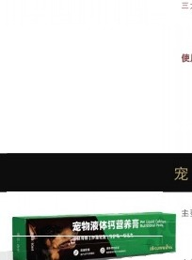
PRODUCT DETAIL
Urinary Nutrition Support
Liquid Nutrition
01
KEY INGREDIENTS / FORMULATION
Plantain, dandelion, cranberry, Alisma and B vitamins
02
PRODUCT POSITIONING
Designed for daily urinary tract nutritional support and related scenarios
APPLICATION
DEVELOPMENT VALUE
Daily urinary tract nutrition support
Suitable for series SKUs and private-label development
BEHOMEI | LOVE PETS, BETTER HOME.
12

Slide 13
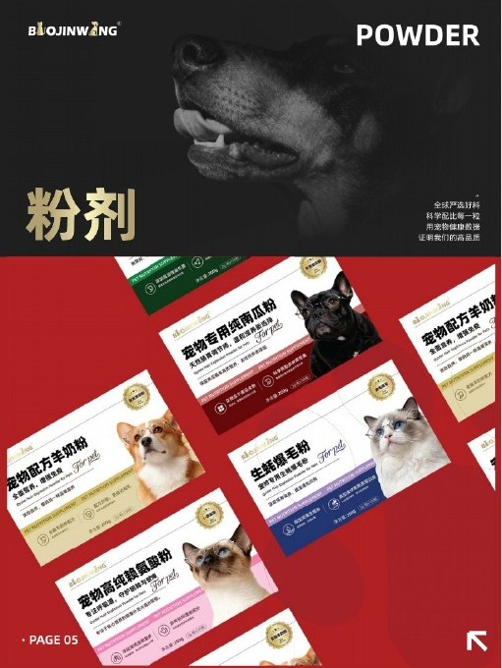
02 / POWDERS
Powders & Functional Nutrition
A mix of gut, nutrition, skin & coat and scenario-based functional products.
BEHOMEI PRODUCT PORTFOLIO
BEHOMEI | LOVE PETS, BETTER HOME.
13

Slide 14
PET NUTRITION
Powder Product Range
Flexible, repeat-purchase friendly functional nutrition SKUs
Pet-formulated goat milk powder
Key direction: Pet-formulated goat milk powder; For weaning, weak/recovering pets, special life stages and senior-pet nutrition
Multi-strain probiotics; the supplied material gives an example of 10 billion CFU per gram
Key direction: Multi-strain probiotics; the supplied material gives an example of 10 billion CFU per gram; For daily gut and microbiome nutrition
Goat Milk Powder
Pet Probiotic Powder
Whole pumpkin powder; low-temperature drying direction
Key direction: Whole pumpkin powder; low-temperature drying direction; Dietary fibre and daily digestive / bowel support
Oyster-related nutritional formulation
Key direction: Oyster-related nutritional formulation; Daily coat care, skin & coat nutrition and seasonal shedding support
Pumpkin Powder
Oyster Hair & Coat Powder
Soft-shell turtle egg, egg-yolk lecithin, CPP, salmon oil and seaweed powder
Key direction: Soft-shell turtle egg, egg-yolk lecithin, CPP, salmon oil and seaweed powder; Omega-3/6, DHA/EPA and skin & coat nutrition direction
Lysine and functional nutrition direction
Key direction: Lysine and functional nutrition direction; Daily nutritional supplementation and product-line combinations for cats
Soft-shell Turtle Egg Hair & Coat Powder
Lysine Functional Powder
BEHOMEI | LOVE PETS, BETTER HOME.
14

Slide 15
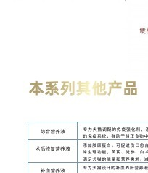
PRODUCT DETAIL
Pet-formulated Goat Milk Powder
Powder
01
KEY INGREDIENTS / FORMULATION
Pet-formulated goat milk powder
02
PRODUCT POSITIONING
For weaning, weak/recovering pets, special life stages and senior-pet nutrition
APPLICATION
DEVELOPMENT VALUE
Pet food brand nutrition lines / specialty channels / functional nutrition
Suitable for OEM / ODM private-label development
BEHOMEI | LOVE PETS, BETTER HOME.
15

Slide 16
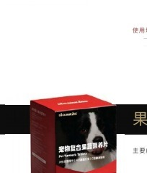
PRODUCT DETAIL
Pet Probiotic Powder
Powder
01
KEY INGREDIENTS / FORMULATION
Multi-strain probiotics; the supplied material gives an example of 10 billion CFU per gram
02
PRODUCT POSITIONING
For daily gut and microbiome nutrition
APPLICATION
DEVELOPMENT VALUE
Pet food brand nutrition lines / specialty channels / functional nutrition
Suitable for OEM / ODM private-label development
BEHOMEI | LOVE PETS, BETTER HOME.
16

Slide 17
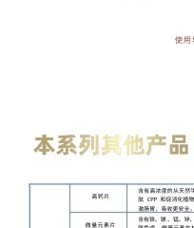
PRODUCT DETAIL
Whole Pumpkin Powder
Powder
01
KEY INGREDIENTS / FORMULATION
Whole pumpkin powder; low-temperature drying direction
02
PRODUCT POSITIONING
Dietary fibre and daily digestive / bowel support
APPLICATION
DEVELOPMENT VALUE
Pet food brand nutrition lines / specialty channels / functional nutrition
Suitable for OEM / ODM private-label development
BEHOMEI | LOVE PETS, BETTER HOME.
17

Slide 18
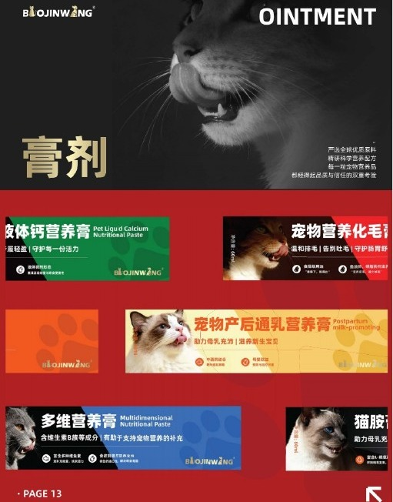
PET NUTRITION
Pastes & Functional Nutritional Pastes
Flexible formats for complete nutrition product lines
Pet Hairball Paste
Liquid Calcium Nutritional Paste
Hairball management
Bone & joint nutrition
Pet Hairball Paste
LIQUIDCalcium Nutritional Paste
Functional Nutritional Pastes
Private-label & SKU expansion
Other functional nutritional pastes
BEHOMEI | LOVE PETS, BETTER HOME.
18

Slide 19
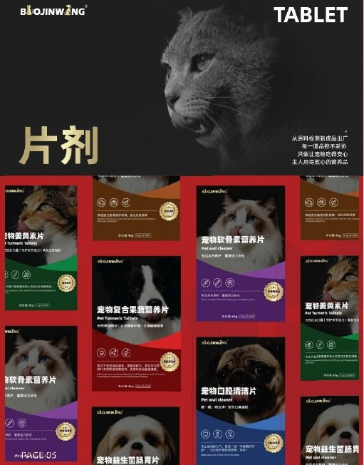
PET NUTRITION
Tablets & Effervescent Tablets
Flexible formats for complete nutrition product lines
High-Calcium Tablet
Trace Mineral Tablet
Calcium nutrition
Trace-mineral nutrition
High-Calcium Tablet
Trace Mineral Tablet
Multivitamin Tablet
Urinary Effervescent Tablet
Daily dog & cat nutrition
Urinary tract nutrition
Multivitamin Tablet
Urinary Effervescent Tablet
BEHOMEI | LOVE PETS, BETTER HOME.
19

Slide 20
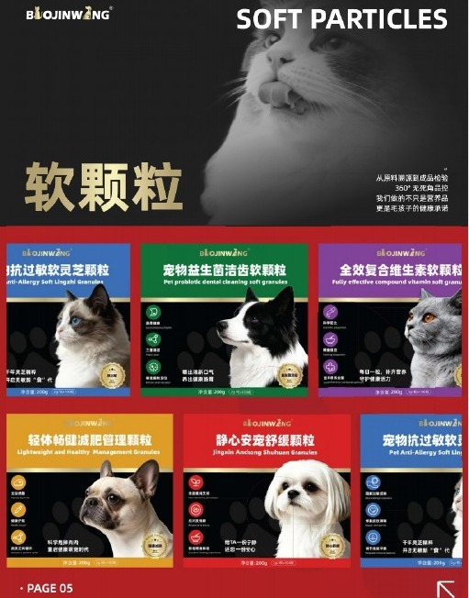
PET NUTRITION
Soft Particles
Flexible formats for complete nutrition product lines
Lecithin
Seaweed Hair & Coat
Skin & coat
Hair & coat / skin
Lecithin Soft Particles
Seaweed Hair & Coat Soft Particles
Chondroitin
Multivitamin
Joint & cartilage
Comprehensive nutrition
Chondroitin Soft Particles
Multivitamin Soft ParticlesSOFT PARTICLES
BEHOMEI | LOVE PETS, BETTER HOME.
20

Slide 21
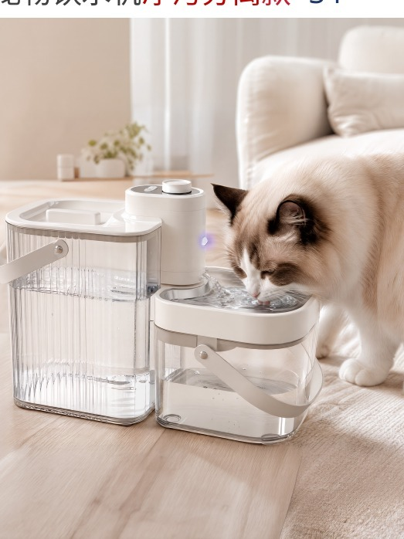
03 / SMART PET SUPPLIES
Smart Pet Supplies
Smart water fountains across clean/dirty separation, water/electricity separation, wireless sensing and plug-in models.
BEHOMEI PRODUCT PORTFOLIO
BEHOMEI | LOVE PETS, BETTER HOME.
21

Slide 22
SMART PET
Smart Water Fountain Architecture
Select the right series by function and price band
01
02
03
04
Clean / Dirty Separation
Water / Electricity Separation
Wireless Sensing
Plug-in
Clean / Dirty Separation
Water / Electricity Separation
Wireless Sensing
Plug-in
S1 / S3 / S4
A01SP / A02 / A04SP / A05SP / W09S / W10S
W01 / W02 / W04SP
W03 / W06
Separate clean/dirty tanks, sensing/auto refill, scheduled drainage and wireless use.
Power isolation, brushless pump and multi-stage filtration; selected models add UVC/UVA.
4000mAh battery, sensing/intermittent/continuous modes and easy cleaning.
Simple plug-in pump, easy cleaning and 4-stage filtration.
BEHOMEI | LOVE PETS, BETTER HOME.
22

Slide 23
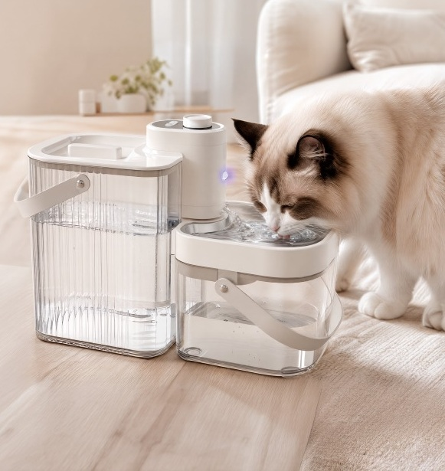
SMART PET / PRODUCT DETAIL
S4 Clean / Dirty Separation Fountain
S4
KEY ADVANTAGE
Clean/dirty separation + consumable-free design + scheduled drainage + 4000mAh
FEATURES
•
Infrared sensing
•
Fresh-water circulation
•
Clean/dirty separation
•
5 scheduled drainage settings
•
Auto refill
•
One-touch drainage
•
Wireless operation
BASIC SPECIFICATIONS
5L clean tank + 2.3L waste tank; 3.7V/4000mAh; 18.8×35.3×25.7cm; 6 PCS
BEHOMEI | LOVE PETS, BETTER HOME.
23

Slide 24
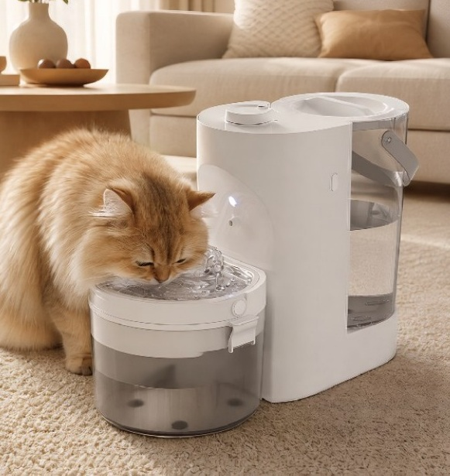
SMART PET / PRODUCT DETAIL
S3 Clean / Dirty Separation Fountain
S3
KEY ADVANTAGE
Clean/dirty separation + auto refill + waste-water reminder
FEATURES
•
Infrared sensing
•
Probe-based auto refill
•
Scheduled drainage
•
Waste-water replacement reminder
•
Wireless operation
BASIC SPECIFICATIONS
3L clean tank + 1.7L waste tank; 3.7V/4000mAh; 19.6×36.7×29.0cm; 6 PCS
BEHOMEI | LOVE PETS, BETTER HOME.
24

Slide 25
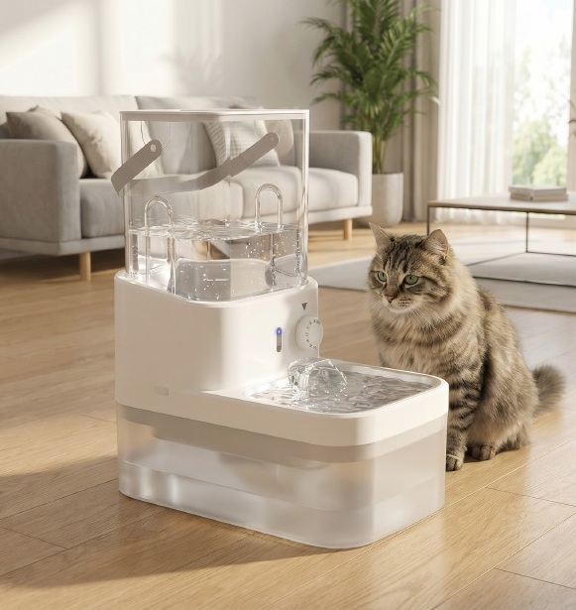
SMART PET / PRODUCT DETAIL
S1 Clean / Dirty Separation Fountain
S1
KEY ADVANTAGE
Radar sensing + gravity refill + clean/dirty separation
FEATURES
•
Radar sensing
•
Gravity auto refill
•
Clean/dirty separation
•
Customized drainage timing
•
One-touch drainage
•
Wireless operation
BASIC SPECIFICATIONS
3L clean tank + 2.7L waste tank; 3.7V/4000mAh; 18×28×33.3cm; 6 PCS
BEHOMEI | LOVE PETS, BETTER HOME.
25

Slide 26
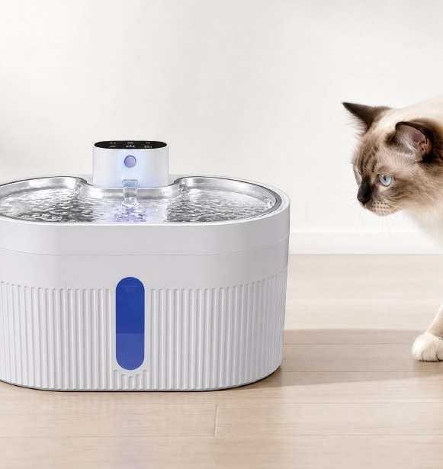
SMART PET / PRODUCT DETAIL
A05SP Water / Electricity Separation Fountain
A05SP
KEY ADVANTAGE
Water/electricity separation + 5-stage filtration + 4000mAh
FEATURES
•
Hidden brushless pump
•
Dry-run power cut-off & quiet operation
•
Sensing / intermittent / continuous modes
•
5-stage filtration
•
Viewing window
BASIC SPECIFICATIONS
4.0L; SUS304 + ABS; 28×18×18.4cm; 8 PCS
BEHOMEI | LOVE PETS, BETTER HOME.
26

Slide 27
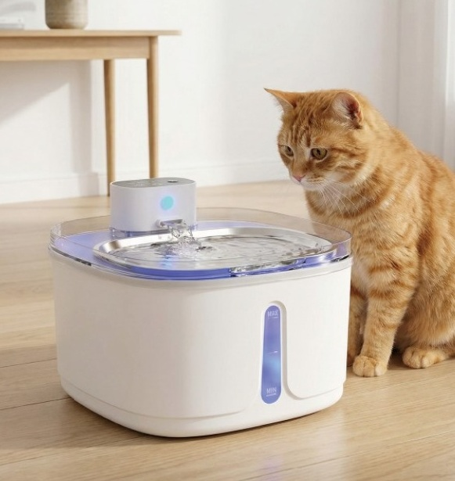
SMART PET / PRODUCT DETAIL
A01SP Water / Electricity Separation Fountain
A01SP
KEY ADVANTAGE
Compact format + water/electricity separation + 5-stage filtration
FEATURES
•
Water/electricity separation
•
Hidden brushless pump
•
Dry-run cut-off
•
Sensing / intermittent modes
•
5-stage filtration
•
4000mAh
BASIC SPECIFICATIONS
3.2L; SUS304 + ABS; 21.5×21.5×16cm; 12 PCS
BEHOMEI | LOVE PETS, BETTER HOME.
27

Slide 28
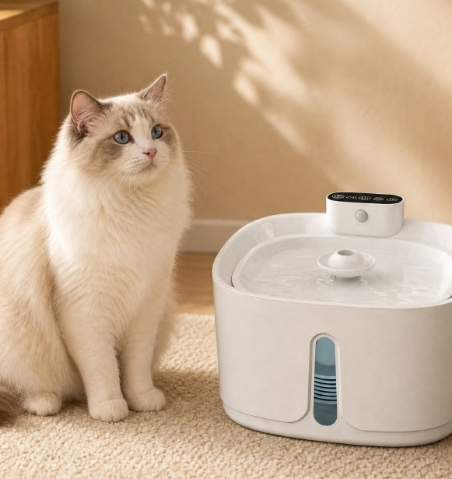
SMART PET / PRODUCT DETAIL
W01 Wireless Sensing Fountain
W01
KEY ADVANTAGE
Wireless placement + 3 modes + easy cleaning
FEATURES
•
Dry-run power cut-off & quiet pump
•
4000mAh
•
Sensing / intermittent / continuous modes
•
4-stage filtration
•
Viewing window
BASIC SPECIFICATIONS
3.2L; eco ABS; 21×21×14.2cm; 12 PCS
BEHOMEI | LOVE PETS, BETTER HOME.
28

Slide 29
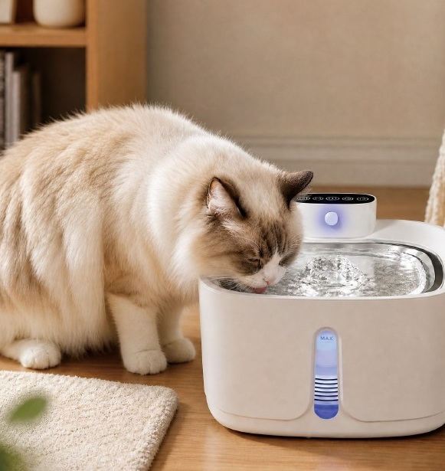
SMART PET / PRODUCT DETAIL
W01SP Wireless Sensing Fountain
W01SP
KEY ADVANTAGE
ABS + 304 stainless steel + wireless sensing
FEATURES
•
Dry-run power cut-off & quiet pump
•
4000mAh
•
3 modes
•
4-stage filtration
BASIC SPECIFICATIONS
3.2L; ABS + 304 stainless steel; 21×21×14.2cm; 12 PCS
BEHOMEI | LOVE PETS, BETTER HOME.
29

Slide 30
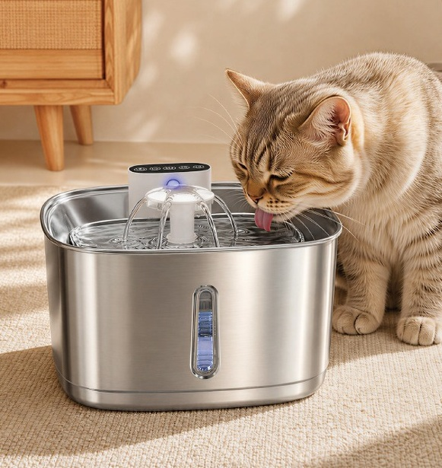
SMART PET / PRODUCT DETAIL
W01S Wireless Sensing Fountain
W01S
KEY ADVANTAGE
304 stainless steel + wireless + 3 modes
FEATURES
•
Dry-run power cut-off & quiet pump
•
4000mAh
•
3 modes
•
4-stage filtration
•
Easy cleaning
BASIC SPECIFICATIONS
3.2L; 304 stainless steel; 21.5×21.5×13.7cm; 12 PCS
BEHOMEI | LOVE PETS, BETTER HOME.
30

Slide 31
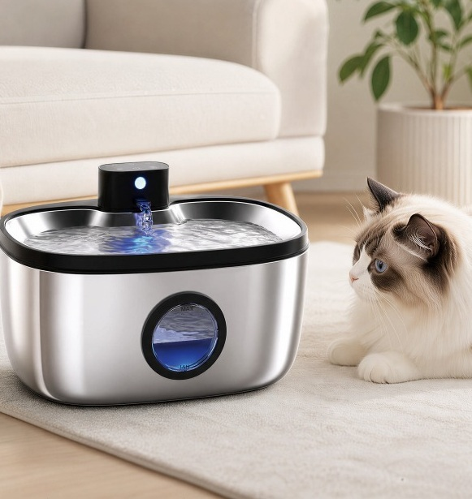
SMART PET / PRODUCT DETAIL
W09S Large-capacity Smart Fountain
W09S
KEY ADVANTAGE
5L + UVC/UVA + 5-stage filtration
FEATURES
•
Water/electricity separation
•
UVC + UVA
•
Filter reminder
•
3 modes
•
Dry-run cut-off
•
5-stage filtration
BASIC SPECIFICATIONS
5.0L; 29.5×21.6×18cm; 8 PCS
BEHOMEI | LOVE PETS, BETTER HOME.
31

Slide 32

SMART PET / PRODUCT DETAIL
W10S Large-capacity Smart Fountain
W10S
KEY ADVANTAGE
7L capacity + UVC/UVA + 4000mAh
FEATURES
•
Water/electricity separation
•
UVC + UVA
•
4000mAh
•
Filter reminder
•
3 modes
•
5-stage filtration
BASIC SPECIFICATIONS
7.0L; 30.6×31×18cm; 4 PCS
BEHOMEI | LOVE PETS, BETTER HOME.
32

Slide 33
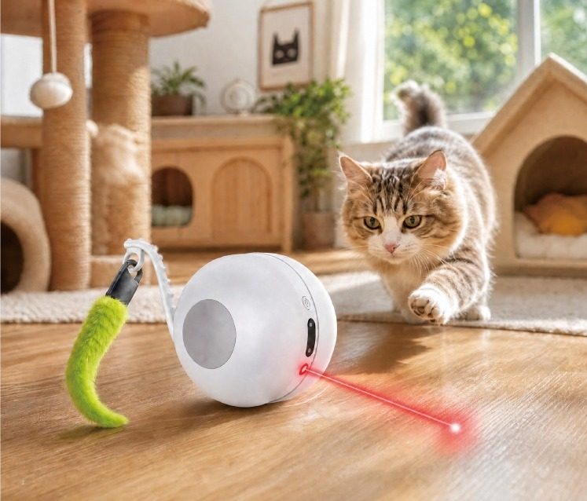
SMART TOY / PRODUCT DETAIL
F1 Smart Interactive Cat Toy Car
Interactive play / smart pet channel product
KEY FEATURES
•
8 random movement patterns
•
Tap-to-wake, automatic play
•
Smart infrared obstacle avoidance
•
Laser + dual sound effects
•
15m remote control, dual modes
•
4000mAh lithium battery, long runtime
PRODUCT DATA
9.7 × 15.7 × 8.7 cm | 350 g
Certifications: CE · FCC · RoHS · PSE · UKCA; FCM · FDA · LFGB · MSDS · UN38.3
BEHOMEI | LOVE PETS, BETTER HOME.
33

Slide 34
OEM / ODM
OEM & ODM Product Development
From proven products to private-label customization for faster market launch
01
02
03
04
05
Product Selection
Customization
Sampling
Mass Production
Replenishment
Selection
Customization
Sampling
Mass Production
Replenishment
Select suitable SKUs from the existing portfolio.
Formula, function, appearance and packaging customization.
Sample confirmation and detail optimization.
Production, quality, packaging and delivery coordination.
Ongoing product development and stable replenishment.
Suitable for: pet brands / e-commerce / wholesalers / retail chains / regional distributors
BEHOMEI | LOVE PETS, BETTER HOME.
34

Slide 35
QUALITY CONTROL
Quality & Delivery
Key-point management for reliable B2B cooperation
01
02
03
04
05
Product Development
Materials & Suppliers
Production
Final Inspection
Documentation & Delivery
Product Development
Materials & Suppliers
Production Process
Final Inspection
Documentation & Delivery
Confirm specifications, functions and packaging requirements.
Coordinate key materials and supply resources.
Production and process control.
Appearance, function, packaging and project requirements.
Specifications, tests, certifications and shipping documents as required.
Certifications and documents are product/project specific; the supplied material lists examples including CE, FCC, RoHS, PSE, UKCA, FCM, FDA, LFGB, MSDS and UN38.3.
BEHOMEI | LOVE PETS, BETTER HOME.
35

Slide 36
SUPPLY CHAIN
Supply-Chain Capability
BeHomei connects qualified manufacturing resources rather than positioning a single factory as its own capacity
110,000㎡
1,200+
60+
Site Area / site area
Employees / employees
Senior Technical Staff / senior technical staff
40+
3,000万+
Design、Tooling、Manufacturing Engineers / engineers
Annual Capacity Example / annual capacity example
These figures come from the supplied Starry Pet Products material and are presented as representative partner manufacturing capability, not BeHomei-owned factory capacity.
BEHOMEI | LOVE PETS, BETTER HOME.
36

Slide 37
BeHomei
Together, we build a
smarter pet-product ecosystem.
BeHomei works with global pet-industry partners to advance the sector toward greater professionalism, intelligence and quality.
Pet Brands / Importers / Wholesalers / Channel Partners
BEHOMEI | LOVE PETS, BETTER HOME.
37

